Slide 1

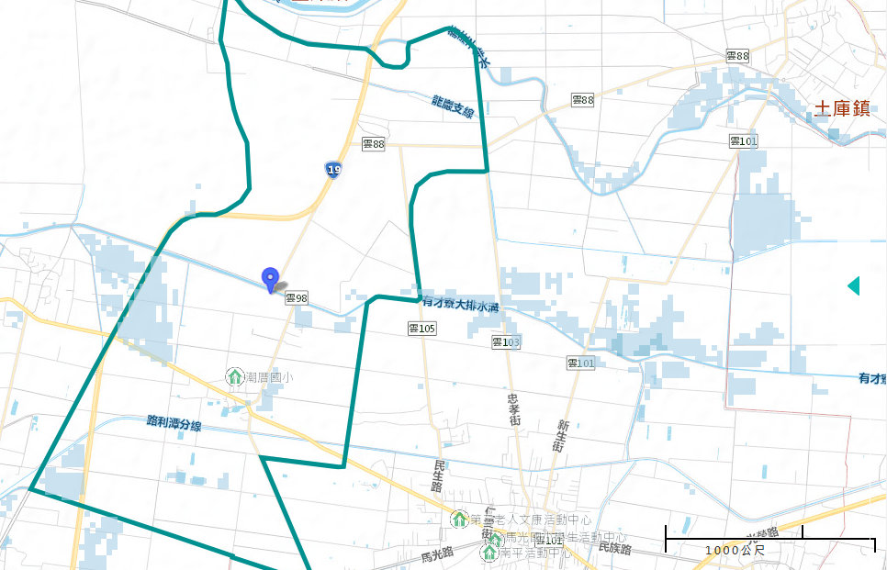
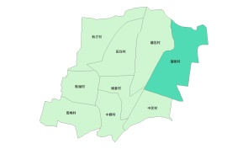





Evacuation Map of Chaocuo Village, Baozhong Township, Yunlin County
Floods
Disaster Prevention Information
Administration Zone
Population：900people
Emergency notification
Baozhnog Township Emergency Operation Center,(EOC)
TEL:05-6972005
Chief of Village: CHEN,CHENG-CONG,(陳成琮)
Mobile:05-697-4558
Baozhong Police Office
TEL:05-697-2040
Baozhong Fire Department
TEL:05-697-2146
Disaster Prevention Information Website
Soil and Water Conservation Bureau
http://246.swcb.gov.tw/
Water Resources Agency
http://www.wra.gov.tw/
Directorate General of Highways
http://www.thb.gov.tw/
(Chaocuo Walderf Experimental Elementary School)
Evacuation Principle
Floods: Vertical refuge. People live in lowlands go to shelters.
Evacuation Shelter
Shelter: Chaocuo Walderf Experimental Elementary School
Accommodate: 33 people
Address:No. 96, Chaocuo, Baozhong Township, Yunlin County 634 , Taiwan (R.O.C.)
TEL: 05-697-2644
Village Boundary
Evacuation Route
Indoor Evacuation Shelter
0.5-1.0 m
1.0-2.0 m
2.0-3.0 m
>3.0 m
Shelter for Flood
Emergency Operation Center, EOC
Made by Baozhong Township Office, May 2022

