Slide 1
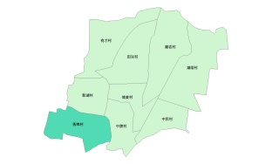
Evacuation Map of Maming Village, Baozhong Township, Yunlin County
Earthquake
Disaster Prevention Information
Administration Zone
Population：1,585people
Emergency notification
Baozhnog Township Emergency Operation Center,(EOC) TEL:05-6972005
Chief of Village: GUO,FENG-LIN,(郭峯霖) Mobile:05-697-6802
Baozhong Police Office TEL:05-697-2040
Baozhong Fire Department TEL:05-697-2146
Disaster Prevention Information Website
Soil and Water Conservation Bureau
http://246.swcb.gov.tw/
Water Resources Agency
http://www.wra.gov.tw/
Directorate General of Highways
http://www.thb.gov.tw/
Evacuation Principle
Earthquake: Take refuge at open spaces or parks.
(Baozhong Township Office)
Evacuation Shelter
Shelter: Baozhong Township Office
Accommodate: 113 people
Address: No. 451, Zhongzheng Rd., Baozhong Township, Yunlin County 634, Taiwan (R.O.C.)
TEL: 05-697-2005
Village Boundary
Evacuation Route
Indoor Evacuation Shelter
Shelter for Earthquake
Made by Baozhong Township Office, July 2022

