Slide 1
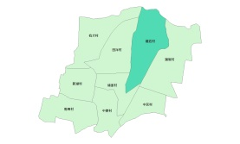
Evacuation Map of Longyan Village, Baozhong Township, Yunlin County
Earthquake
Disaster Prevention Information
Administration Zone
Population：1,303people
Emergency notification
Baozhnog Township Emergency Operation Center,(EOC) TEL:05-6972005
Chief of Village: ZHUANG,QING-RONG,(莊清榮) Mobile:05-697-1542
Baozhong Police Office TEL:05-697-2040
Baozhong Fire Department TEL:05-697-2146
Disaster Prevention Information Website
Soil and Water Conservation Bureau
http://246.swcb.gov.tw/
Water Resources Agency
http://www.wra.gov.tw/
Directorate General of Highways
http://www.thb.gov.tw/
Evacuation Principle
(Chaocuo Walderf Experimental Elementary School)
Earthquake: Take refuge at open spaces or parks.
Evacuation Shelter
Shelter: Chaocuo Walderf Experimental Elementary School (1-11Neighborhood)
Accommodate: 33 people
Address:No. 96, Chaocuo, Baozhong Township, Yunlin County 634 , Taiwan (R.O.C.)
TEL: 05-697-2644
Village Boundary
Evacuation Route
Indoor Evacuation Shelter
Shelter for Earthquake
Made by Baozhong Township Office, August 2022

